Slide 1

Smart Pot Hole Detection Using IOT
Seminar on
Submitted By
Nishi Mandhana(22)
Archana Sahu(25)
Shambhu Ajwani(78)
Shrikant Rathi(82)
Shubham Reddy(83)
Under the guidance of:
Prof. D.R.Naidu
Shri Ramdeobaba College of Engineering & Management, Nagpur
(An Autonomous College under RTM Nagpur University)

Slide 2
Problems
Perceiving Pothole Profiles with Participatory Urban Vehicles”, Over the past few years, there has been a large increase in vehicle population. This increase in vehicle population has led to increasing road accidents and also traffic congestion. According to Global Road Safety Report, 2015 released by the World Health Organization
(WHO), India accounts for more than 200,000 deaths because of road accidents. These accidents can be due to over speeding, drunk and driving, jumping traffic signals and also due to humps, speed-breakers and potholes.

Slide 3
Outline Of Presentation
Problem Definition
Motivation behind project
Case studies and research paper on “Smart pit Hole Detection”
Boon of project
Hardware and software requirements
Explanation of Algorithms use for implementation of Project
Test case And Module demo
Propose plan of work
-- 3 --

Slide 4
Pothole detection using Arduino and Internet of Things
Problem Definition:
To design a device for an application using IOT that will detect a pothole on the road. It will indicate pit by sending alert in the form of colored marks o map on mobile or PC to alert the user.

Slide 5
Proposed Plan of Work
Sr. No. | PHASES | TIME DURATION
1. | Software And Hardware Requirement Specification | 2 weeks
2. | Device Design | 3 weeks
3. | Coding | 4 weeks
4. | Implementation | 5 weeks
5. | Testing | 1 week
-- 5 --

Slide 6
References
#1. Pothole Detection: An Efficient Vision Based Method Using RGB Color Space Image Segmentation Conference Paper · May 2017 with 3,032 Reads DOI: 10.23919/MIPRO.2017.7973589 Conference: The 40th International Convention on Information and Communication Technology, Electronics and Microeletronics, Opatija, Croatia
#2. A Real-Time Pothole Detection Approach for Intelligent Transportation System Institute of Information Management, ²Telecommunication Laboratories, ³Department of Information Management
#3.Convolutional neural networks based potholes detection using thermal imaging Journal of King Saud University - Computer and Information Sciences
#4. ANAUTOMATIC ROAD DISTRESS VISUAL INSPECTION SYSTEM USING AN ONBOARD IN-CAR CAMERA (Thitirat Sirborvornratanakul Graduate School os Applied Statistics, National Institute of Development Administration (NIDA) , 118 Seri Thai Rd. Bangkapi ,Bangkok , Thailand)
#5. Image Based Pothole Detection System for ITS Service and Road Management System (Seung-Ki Ryu,1 Taehyeong Kim,1 and Young-Ro Kim2 1Highway and Transportation Research Institute, Korea Institute of Civil Engineering and Building Technology, 283 Goyangdae-ro , Ilsanseo-gu,goyang-si 411-712, Republic of Korea 2Department of Computer Science and Information, Myongji College, Seoul 120-848,Republic of Korea)

Slide 7
TECHNOLOGIES
1)Arduino:- A board used for reading inputs that uses IOT and programmes the hardware.
2) Arduino IDE
2)Zigbee : Connection purposes
3)GSM module:-A chip or circuit that will be used to establish communication between a mobile device or a computing machine and a GSM or GPRS system & for locating coordinates on map.
4)IR sensors:An electronic instrument that is used to sense certain characteristics of its surroundings. It does this by either emitting or detecting infrared radiation
5)Ultrasonic sensors: For measuring distance at which objects are placed infront of it.
6)LCD :For displaying the parameters of ultrasonic and IR sensors.
7)Max 232:-An IC utilized for developing serial communication between Microcontrollers and also Personal Computers (PC).
8)Python/C language - Writing code.

Slide 8
FUTURE USE OF POTHOLE DETECTION
+-.
Provides Information to PWD so that they can know in advance and repair the pothole on time.
It can helps to know in advance which road or path to use.
The sensors will be attached to vehicles and from vehicles the data’s obtained from sensors and the location obtained by the GPS are transferred to road transport authority by IOT .
Using the data’s obtained more damaged area can be prioritized and damage control can be reduced.

Slide 9
Pothole properties measurement make it easier and automatic while a vehicle passes through visual 2D recognition and 3D reconstruction while a vehicle passes through a pothole.
Can Avoid personnel check
Affected Area gets recovered first
Provides reliable database about accident prone areas
Increase the comfort of the driver
Can function efficiently in any weather condition.

Slide 13
Hence it is important to collect information regarding these poor road conditions and distribute the same to other vehicles that in turn help reduce accidents caused due to potholes and humps.

Slide 14
Motivation
We are going to develop a effective road surface monitoring system for automated pothole detection.
This is a low cost solution for the road safety purpose.
This will help to avoid accidents and can use to identify problem areas early.
The authorities can be alerted to take preventive actions; preventive actions can save
Money
Notification to Users.
Updating a per the latest road condition

Slide 16
Working of device
*The system comprises of an Accelerometer, GPS Receiver, Arduino Board, a server and a custom made mapping application.
* The accelerometer will produce values of X, Y, Z axes (coordinates).
The GPS receiver provides the latitude and longitude coordinates.
The Arduino Board is used as a communicating interface between the GPS and the accelerometer and a server which is used to receive the data and send it to the server for classification and storage.
The server, on receiving the coordinates of the irregularity, classifies them based on the severity and stores them in the database.
The mapping application, which is custom made, is designed to accept the source and the destination and shows the presence of any irregularities on the path.

Slide 18
Implementation
The system consists of a device that is designed by integrating an accelerometer, GPS with help of an Arduino Board.
The accelerometer can be utilized to detect dynamic force like vibrations due to its high sensitivity to a very small change too. This method is not only feasible but flexible i.e. can be used in any environment (on any vehicle) just by changing the sensitivity of the device.
The overall system is cost effective and highly reliable in terms of accuracy. It forms an intelligent system which operates without any human intervention and reduces reliance on manual methods for maintenance of record and detection.

Slide 19
Accelerometer in conjunction with GPS module is an innovative approach to design an efficient system to map all the damaged roads all across the globe.
The coordinates, obtained when the vehicle encounters a pothole, is sent to the server that uses an algorithm to classify the pothole based on its severity and stores it in the database.
These coordinates are used to display the locations and the severity of the potholes on the mapping application.

Slide 20
CONCLUSION
This will be an important tool to avoid accidents in the place where the risk of accident or injury is substantial.
Irregularities are more dangerous in low visibility conditions, such as night time, or foggy conditions, rain or snow. It also provides a novel method to have a reliable database about the road conditions and accident prone areas and can be further used to upgrade infrastructure.
The project can be extended to enhance the suspension systems of low cost vehicles and increase the comfort of the driver.

Slide 21
ADVANTAGES
Reducing the time invested by personnel in monitoring damaged roads.
Can be implemented in any vehicle without causing any change in the mechanism of the vehicle.
It can function effectively and efficiently in any weather condition.

Slide 22
Module contains
Assembly of components
Coding
Desing the diagram and other
Testing

Slide 23
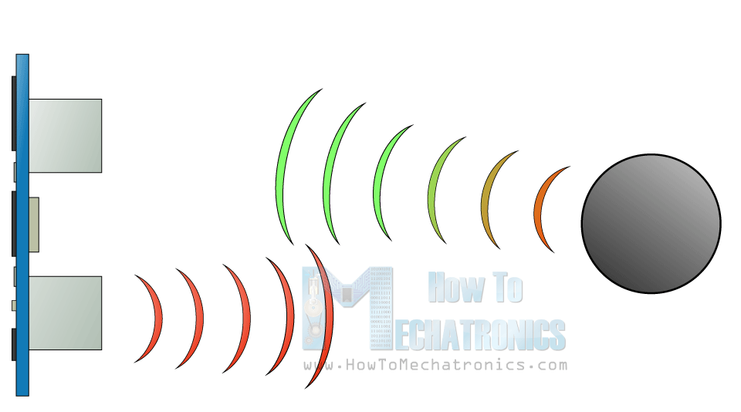
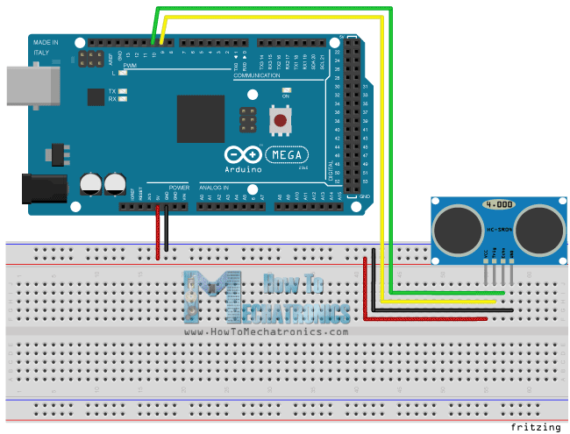
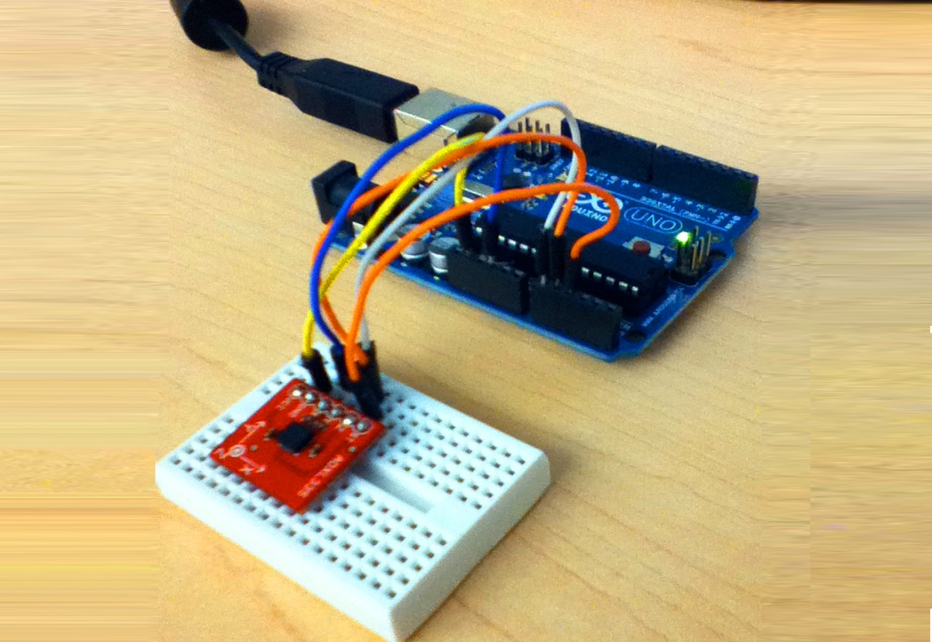

Slide 24
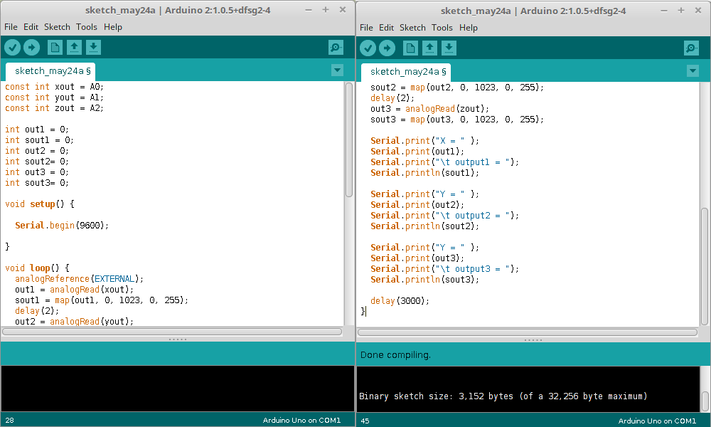

Slide 25
Test cases
To test in a dry condition
To test in a vehicle
To calculate the distance between vehicle and pothole
To identify the location on map

Slide 26
